Slide 1
Title: Sampling
Need whiteboards and calculators.
Aim:
Know 4 methods of sampling.
Know the difference between sample and census.
Plan:
Daily Review – mean, mode, median.
Sampling.

Slide 2

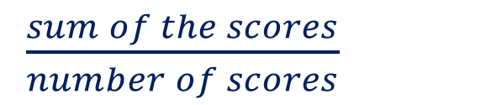
Daily Review – mean, mode, median.
Reteach:
$\frac{sum of the scores}{number of scores}$
Mean =
= $\frac{\sum{x}}{n}$
Median =
Middle
The centre score when scores are put in order.
Mode =
Most
Most frequently occurring score.

Slide 3


Apply -
White-boards
Calculate the mean of 34, 36, 38, 40, 42
$\frac{\sum{x}}{n}$
Mean =
$$= \frac{190}{5}$$
$=38$
or
Mean : as scores are in a pattern the mean will be
the middle score.

Slide 4
Calculate the median of 34, 36, 38, 40, 42
Median = middle
= 38

Slide 5
Without calculating: which would be higher, the mean or the median?
34, 36, 38, 40, 4200
Mean as it is influenced by the extreme score of 4200. The median is not affected.

Slide 6
Calculate the mode of
34, 36, 38, 40, 42, 34, 36, 38, 44, 34,44
Mode = most
= 34

Slide 7
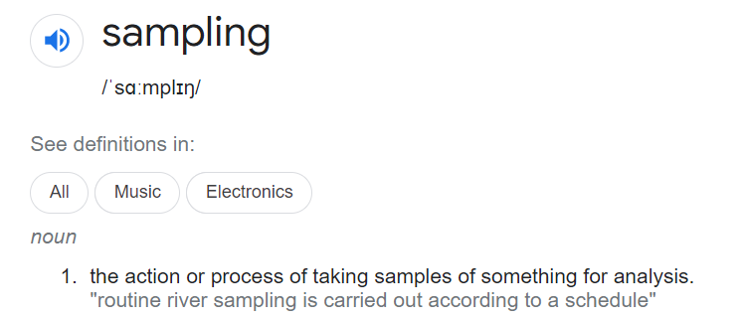
Sampling

Slide 8
Our focus is sampling a population.
Census versus sample.
Census:
When the whole target population is surveyed.
Sample:
When a proportion of the population is surveyed.
Survey: Questions to find out some particular information.
 | Advantages | Disadvantages
Census
Sample
Can be hard to do.
Whole population surveyed so most accurate results.
Can be expensive.
Can be time consuming.
Time efficient.
We have to be sure that the sample is a fair representation of the target population.
Not as expensive.
Easier to deal with a smaller
group of people.

Slide 9
Our focus is sampling a population.
Census versus sample.
Census:
Sample:
Survey:
 | Advantages | Disadvantages
Census
Sample
Notes:
Student worksheet

Slide 10
Review
What is the difference between a sample and a census.
Pair – share
Be prepared to answer.

Slide 11
Sampling situation.
It is believed that the students of Busselton SHS are generally taller than students in other regions.
To find out: Determine the average height for students at Busselton SHS and compare to other high schools.
Survey question:
“How tall are you?”
Census or Sample?
Sample as it would be too hard and too time consuming to survey all students.
How many in the sample?

Slide 12
How many in the sample?
How to choose a sample size (for the statistically challenged)
The minimum sample size is 100
Most statisticians agree that the minimum sample size to get any kind of meaningful result is 100. If your population is less than 100 then you really need to survey all of them.
A good maximum sample size is usually 10% as long as it does not exceed 1000.
Busselton SHS has a population of 682, so we would need a sample size of _____
Notes:
Student notes

Slide 13
How many in the sample?
How to choose a sample size (for the statistically challenged)
The minimum sample size is 100
Most statisticians agree that the minimum sample size to get any kind of meaningful result is 100. If your population is less than 100 then you really need to survey all of them.
A good maximum sample size is usually 10% as long as it does not exceed 1000.
Busselton SHS has a population of 682, so we would need a sample size of _____
100

Slide 14
Busselton SHS has a population of 682, so we should have a sample size of 100.
The 100 in the sample should reflect the proportions in each year group.
Complete the following table.
Year | Population | Proportion | # in survey
7 | 113
8 | 133
9 | 135
10 | 113
11 | 104
12 | 84
Notes:
Student notes

Slide 15
Busselton SHS has a population of 682, so we should have a sample size of 100.
The 100 in the sample should reflect the proportions in each year group.
Complete the following table.
Year | Population | Proportion | # in survey
7 | 113
8 | 133
9 | 135
10 | 113
11 | 104
12 | 84
This is called stratified sampling.
The total population is split up into layers, in this case year groups.
Notes:
Student notes

Slide 16
How do we select the students? (The sample)
We need to select 17 Year 7 students out of the population of 113. The selection needs to be fair and every student needs the same chance of selection.
Methods of sampling:
Random:
Systematic:
Self selecting (volunteer):

Slide 17
How do we select the students? (The sample)
We need to select 17 Year 7 students out of the population of 113. The selection needs to be fair and every student needs the same chance of selection.
Methods of sampling:
Random:
Systematic:
Self selecting (volunteer):
Each student is allocated a number and then use a random number generator.
The name of each student is written on a piece of paper and randomly drawn from a hat.
Students are listed alphabetically and every fifth student is selected
A call for volunteers is put out through the notices.

Slide 18
Review:
List the 4 types of sampling discussed today.
Stratified
Random
Systematic
Volunteer
Notes:
Work sheet

Slide 19
Review:
List the 4 types of sampling discussed today.
Notes:
Work sheet

